Slide 1
Gamer Station
A Singular Web Project

Slide 2

Customer's requirement
A responsive web page with Gaming topics (new games, weekly best seller games, new gaming trailers)
The project should contain 3 pages:
Login page
Home page with different sections
Ranking page with different categories
The page should use the following color palette:

Slide 3
Customer's requirement II
The home page should contain the following components:
A sidebar menu with collapse effect
A comment section that allow users to post messages.
A normal nav menu with page title and other relevant links

Slide 4
Implementation:
This project has been implemented using the following:
Bootstrap v4.5 for the page layout and basic component styling
jQuery for sidebar menu control
Animate.CSS for login panel animation
Fontawsome v5 for page icons

Slide 5
Implementation II:
Adaption > Programming
Component credits:
This project won't be possible without the following open sourced components released on the Internet:
Elegant Login Page by SamimOnline Click here
Sidebar menu by Ondrej Click here

Slide 6
DEMO
Page is running locally on Python Web Server:
You can check it on your browser by typing the following private address:
http://10.1.11.75:8000/login.html
The page is responsive, login on computer or mobile, the page is adapted for different screen size.

Slide 7

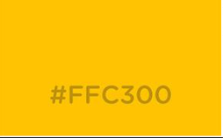

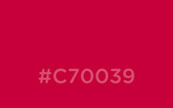
Behind the scene:
Primary color
Menus background color
Text color
Meus's border color and menu item's background color

Slide 8
Behind the scene II:
Sidebar menu logic:
assign an active CSS class with the following style:
#sidebar.active {
margin-left: -250px;
transform: rotateY(100deg);
}
(This hides the side menu)
Control the sidebar menu state (open/close) using the following jQuery logic:
$('#sidebarCollapse').on('click', function () {
$('#sidebar').toggleClass('active');
$(this).toggleClass('active');
});

Slide 9
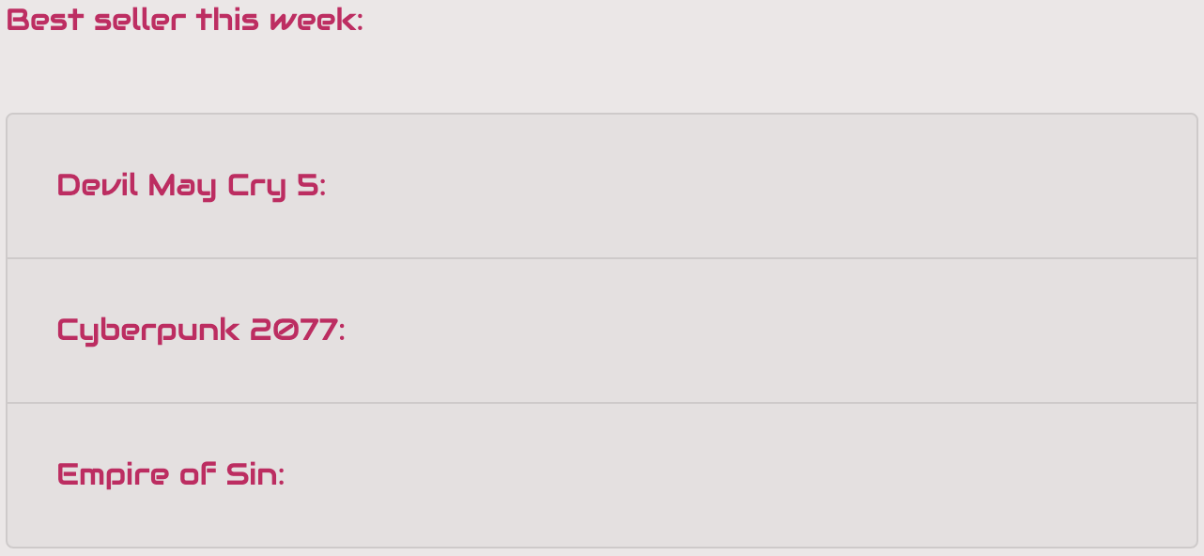

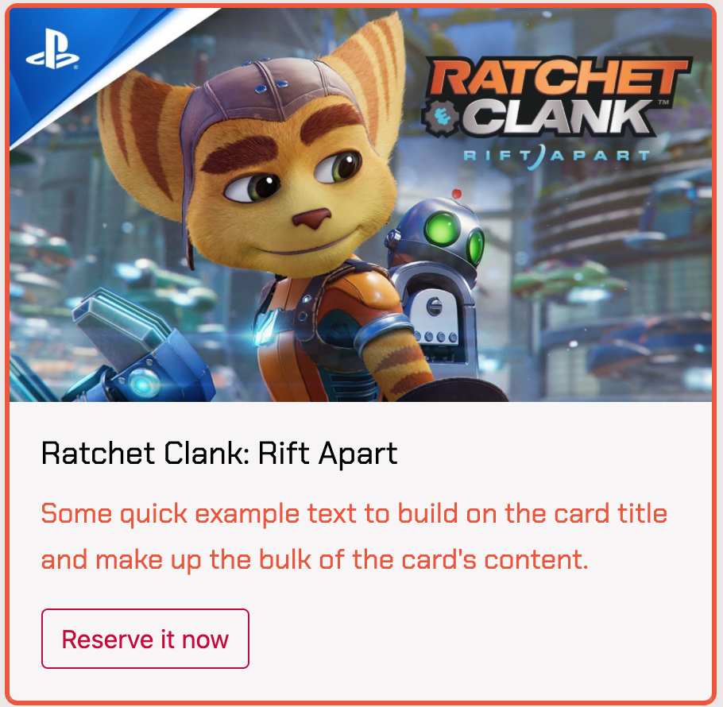
Behind the scene III:
Boostrap components:
Accordion
carousel with indicator
card

Slide 10
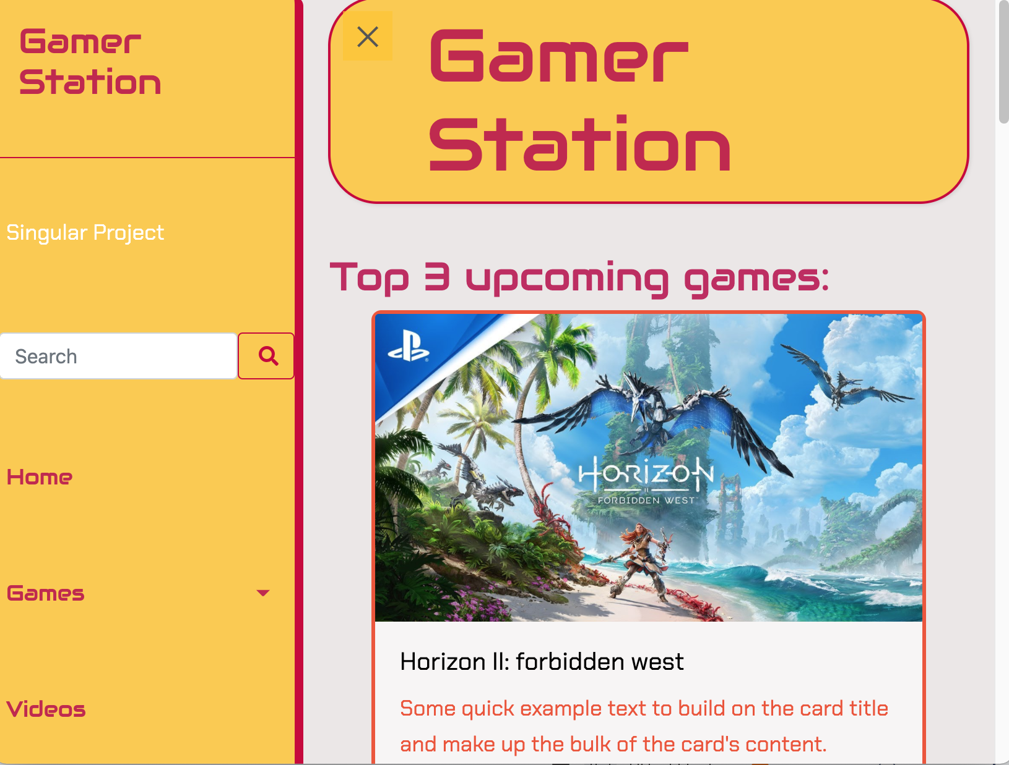
Challenges:
Opened sidebar menu breaks the page layout in a small/middle size screen
Solution:
Force the sidebar menu ocupy 100% width of the page in the small screen size.
User will never see the sidebar menu and the content section at the same time in the mobile device.

Slide 11

Challenges II:
Solution:
On big screen we present the links with text
On small screen we present the links with icons
No social media links on landscape mode in mobile device
No social media links on potrait mode in tablet device
Title menu spacing management
Nav menu has extra space on big screen
Nav menu has little space on small screen
Difficult to adapt the social media links

Slide 12
Improvements:
Comment sections
This component doesn't really simulate a comment component
It should be simulated as a "real" comment section in the future.

